Slide 1
Hospitalization Stays
Regression Analysis
113
hospitals
2
MSDS 6372
objectives
Josh Samuel & Aayush Dalal
3
models compared
1

Slide 2
PROJECT OVERVIEW
Introduction
Hospitals want to understand what drives length of stay
Response: average length of stay, measured in days
Objective 1: evaluate infection risk after accounting for hospital factors
Objective 2: compare models for predicting future stays
2

Slide 3
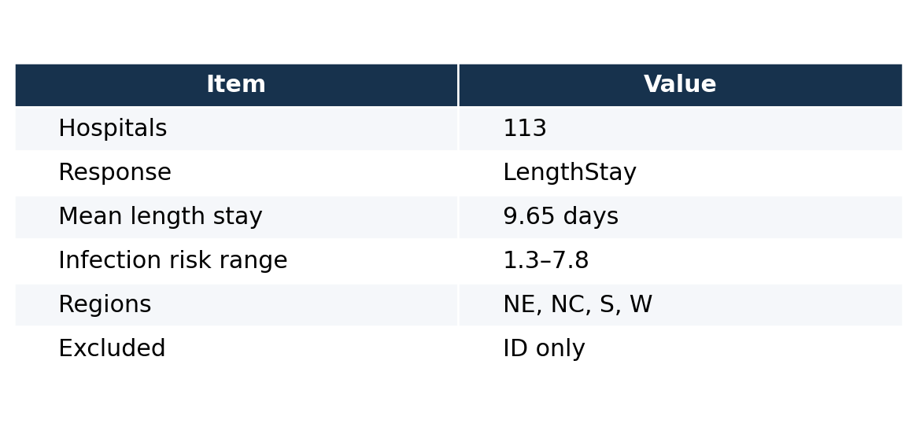
DATA OVERVIEW
Data Preparation
Modeling decisions
Response variable: LengthStay
ID excluded because it only identifies hospitals
Region and MedSchoolAffiliation treated as categorical
3

Slide 4
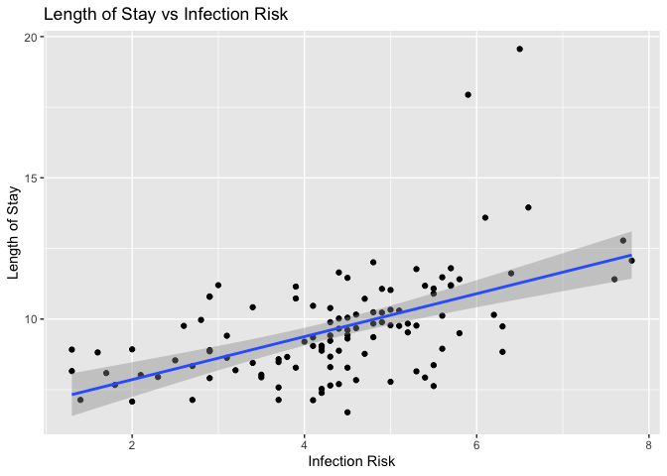
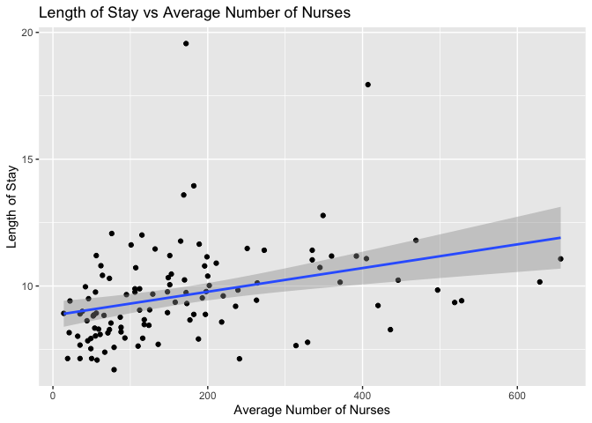
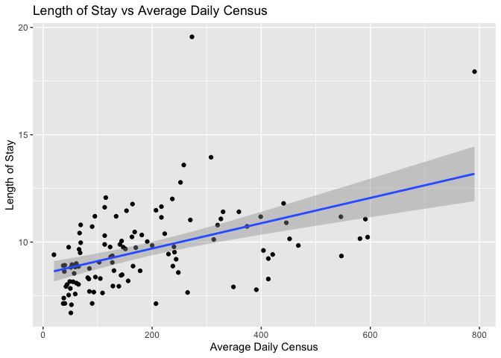
EDA
Exploratory Trends
Infection risk shows the clear positive trend with length of stay
Average number of nurses and daily census also trend upward
These variables were carried into the regression modeling stage
4

Slide 5
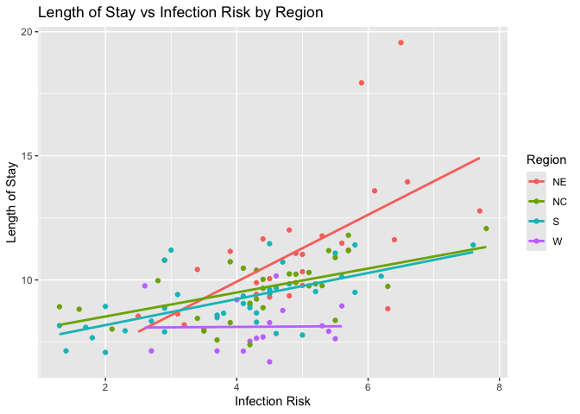
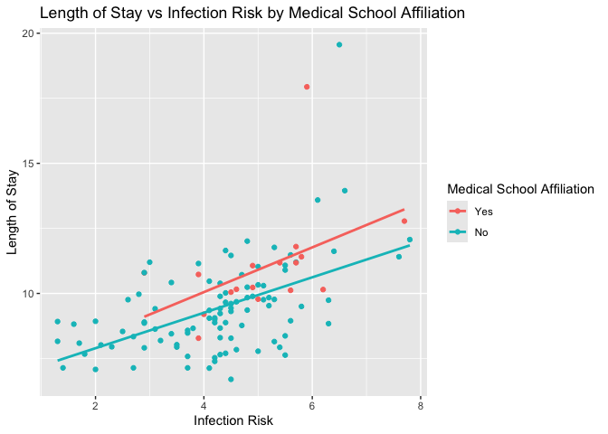
EDA
Interaction Exploration
Why this matters
The infection-risk slope is not identical across regions
This motivates an InfectionRisk × Region interaction
The interaction is used later as the added-complexity MLR model
Explored InfectionRisk x MedSchoolAffiliation possible interaction but no clear added value so dropped for parsimony
5

Slide 6
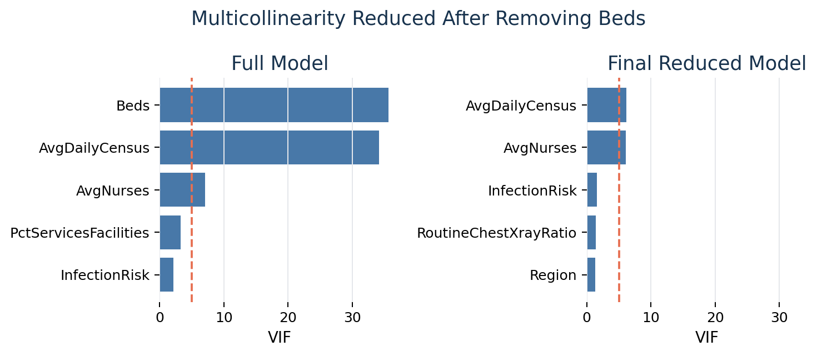
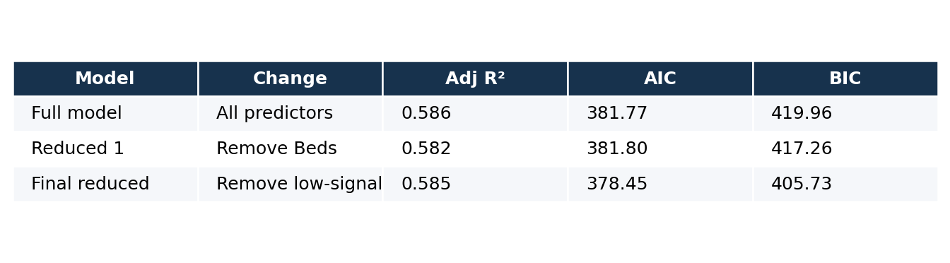
INTERPRETABLE MLR
Objective 1 Model Development
Goal: explain average length of stay
Fit full MLR model using all hospital predictors
Checked statistical significance, VIFs, AIC/BIC, and diagnostics
Removed Beds due to severe collinearity with AvgDailyCensus
Removed low significance variables to improve parsimony
Final reduced model had the best AIC and BIC with similar adjusted R²
6

Slide 7
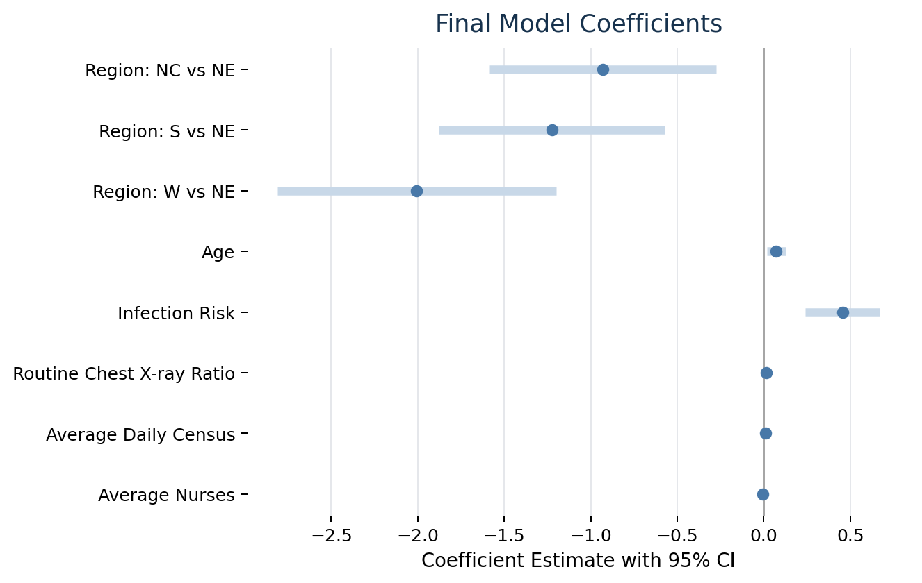
COEFFICIENT RESULTS
Final Objective 1 Model
Final Model
Pred (LengthStay) = 3.044 + 0.072(Age) + 0.456(InfectionRisk) + 0.014(RoutineChestXrayRatio) − 0.932(RegionNC) − 1.224(RegionS) − 2.005(RegionW) + 0.0097(AvgDailyCensus) − 0.0072(AvgNurses)
Model Fit
R² = 0.614
Adjusted R² = 0.585
Overall model p < 0.001
7

Slide 8
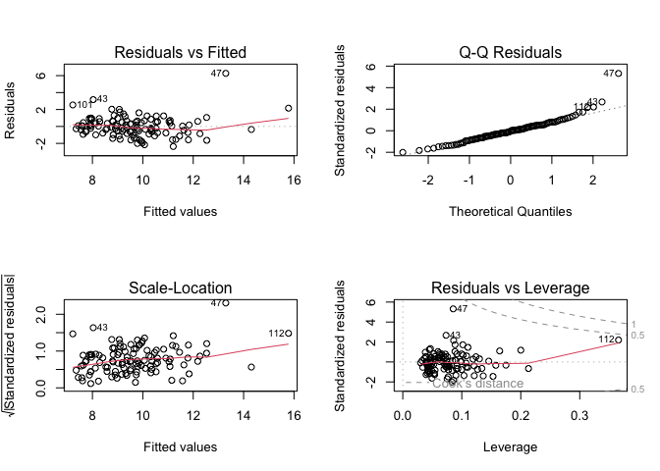
OBJECTIVE 1
Model Diagnostics
Diagnostic summary
Residuals did not show major linearity concerns
Q-Q plot showed minor upper-tail departures
No issue was severe enough to reject the model for Objective 1 interpretation
9

Slide 9
OBJECTIVE 1
Objective 1 Key Findings / Conclusion
+0.456 days
Positive relationship remains after controlling for other hospital factors
Confidence interval excludes 0, supporting statistical significance
Region, age, census, and nurses also showed meaningful associations
estimated increase in average length of stay for a one-unit increase in infection risk while the other variables are held constant
95% CI: 0.241 to 0.671 days
8

Slide 10
PREDICTION
Objective 2 Model Comparison
Goal: Predict future hospital length of stay as accurately as possible
Objective 1 MLR
Evaluation
1
Baseline interpretable regression model
10-fold cross-validation
Primary metric: RMSE
Secondary metric: MAE
Recommendation based on predictive error
2
Interaction MLR
Adds InfectionRisk × Region
3
Random Forest
Nonparametric comparison model
10

Slide 11
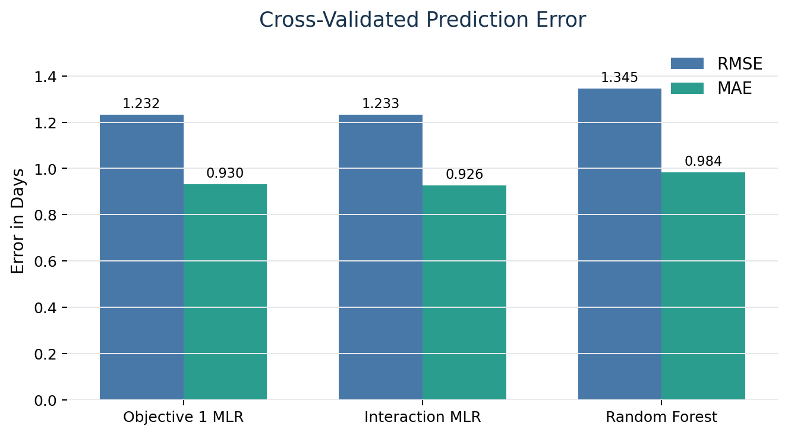
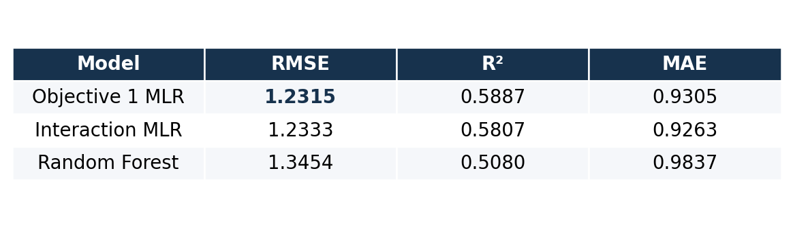
OBJECTIVE 2
Prediction Results
Objective 1 MLR had the lowest RMSE: 1.2315 days
Interaction MLR had the lowest MAE: 0.9263 days
Both regression models outperformed Random Forest
11

Slide 12
FINAL REMARKS
Recommendation & Conclusion
Recommended model: Objective 1 MLR
Lowest cross-validated RMSE among the three models
Interpretable and parsimonious compared with more complex alternatives
Infection risk is positively associated with average hospital length of stay
Random forest did not improve prediction in this small sample
Limitations
• 113 hospitals
• Results may not generalize to all hospitals
• Future work: external validation, additional interactions, and testing more nonparametric models
13

